Slide 1
Employee data analysis using excel
STUDENT NAME: Mohammed Fasil
Register no: 312202270(asunm123312202270)
Department: b.com ca
College : mohammed Sadhak college of arts and science

Slide 2
PROJECT TITLE
Employee Attrition Analysis Using Excel Dashboards

Slide 3
AGENDA
1. Problem Statement
2. Project Overview
3. End Users
4. Our Solution and Proposition
5. Dataset Description
6. Modelling Approach
7. Results and Discussion
8. Conclusion

Slide 4
PROBLEM STATEMENT
A Company struggles to efficiently analyze employee data scattered across multiple spreadsheets,leading to difficulties in tracking workforce trends and making informed HR decisions.This project will use Excel to streamline data analysis,automate reporting,and provide insights into key HR metrics for improved decision-Making.

Slide 5
PROJECT OVERVIEW
This project focuses on developing a robust employee data analysis solution using Excel.By consolidating employe data into a unified spreadsheet,the project will enable streamlined analysis of key HR metrics such as employee turnover,performance,and demographics.Automated dashboards and reporting tools will be created to provide realtime insights,helping HR teams make data driven decisions that enhance workforce management and strategic planning.

Slide 6
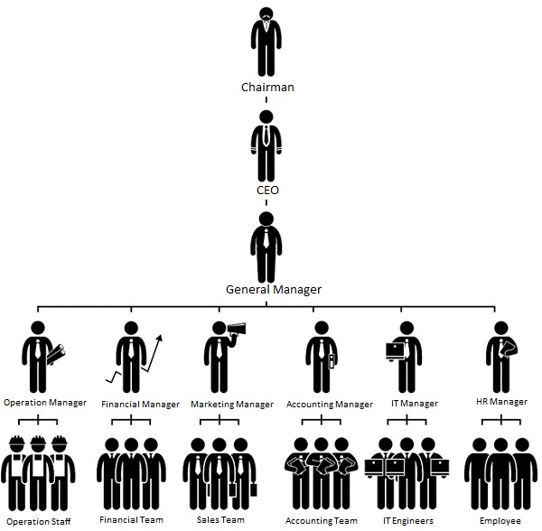
WHO ARE THE END USERS?

Slide 7
OUR SOLUTION AND ITS VALUE PROPOSITION
Conditional formatting - missing
Filter – remove
Formula – performance
Pivot table – summary
Graph – data visualizition

Slide 8
DATASET DESCRIPTION
Employee=- Kaggle
26-features
9-features
Employee type
Performance level
Gender-male female
Employee rating-num

Slide 9
THE “WOW” IN OUR SOLUTION
Performance level = IF(Z8>=5,”VERY HIGH”,Z8>=4,”HIGH”,Z8>=3,”MED”,”TRUE”,”LOW”)

Slide 10
MODELLING
Data collection:
1.Gather employee demographic information(e.g.,age,gender,department,role).
2.Collect employee performance data(e.g.,ratings,achievements,training).
3.Obtain employee status details(e.g.,hire date,tenure,turnover status).

Slide 11
Feature Collection:
1.Select key performance indicators such as attendance,productivity,and training completion.
2.Include demographic features like department,role,and tenure for deeper analysis.
Data Cleaning:
1.Remove duplicate entries and correct data inconsistencies.
2.Handle missing values using techniques like imputation or exclusion,depending on the data’s impact.
Performance Level:
1.Define performance tiers(e.g.,very high,high,medium,low)based on employee ratings or achievements.
2.Establish criteria for identifying top performers and at-risk employees.

Slide 12
Summary:
1.Create summary statistics for employee demographics(e.g.first name,average age,business units,gender).
2.Analyze performance trends across department and roles.
3.Identify any notable patterns in employee turnover and retention rates.
Visualization:
1.Build dynamic charts to display department-wise performance distribution.
2.Create dashboards showcasing employee turnover trends over time.
3.Design interactive pivot tables for exploring various HR metrics,such as performance vs.tenure.

Slide 13
RESULTS

Slide 14
RESULTS

Slide 15
CONCLUSION
In this project,Excel was used effectively to analyze employee data,revealing key insights into workforce trends and performance.By leveraging various Excel functions and tools,we streamlined data management and gained valuable information that can guide HR

